Slide 1
Why Does My Computer Do That? Intro to Coding with Python– Documentation
Dr. Ab Mosca (they/them)
Slides based off slides courtesy of Jordan Crouser (https://jcrouser.github.io/)

Slide 2
Plan for Today
Tracing code
Documenting code

Slide 3
In the beginning…

Slide 4
Now…

Slide 5
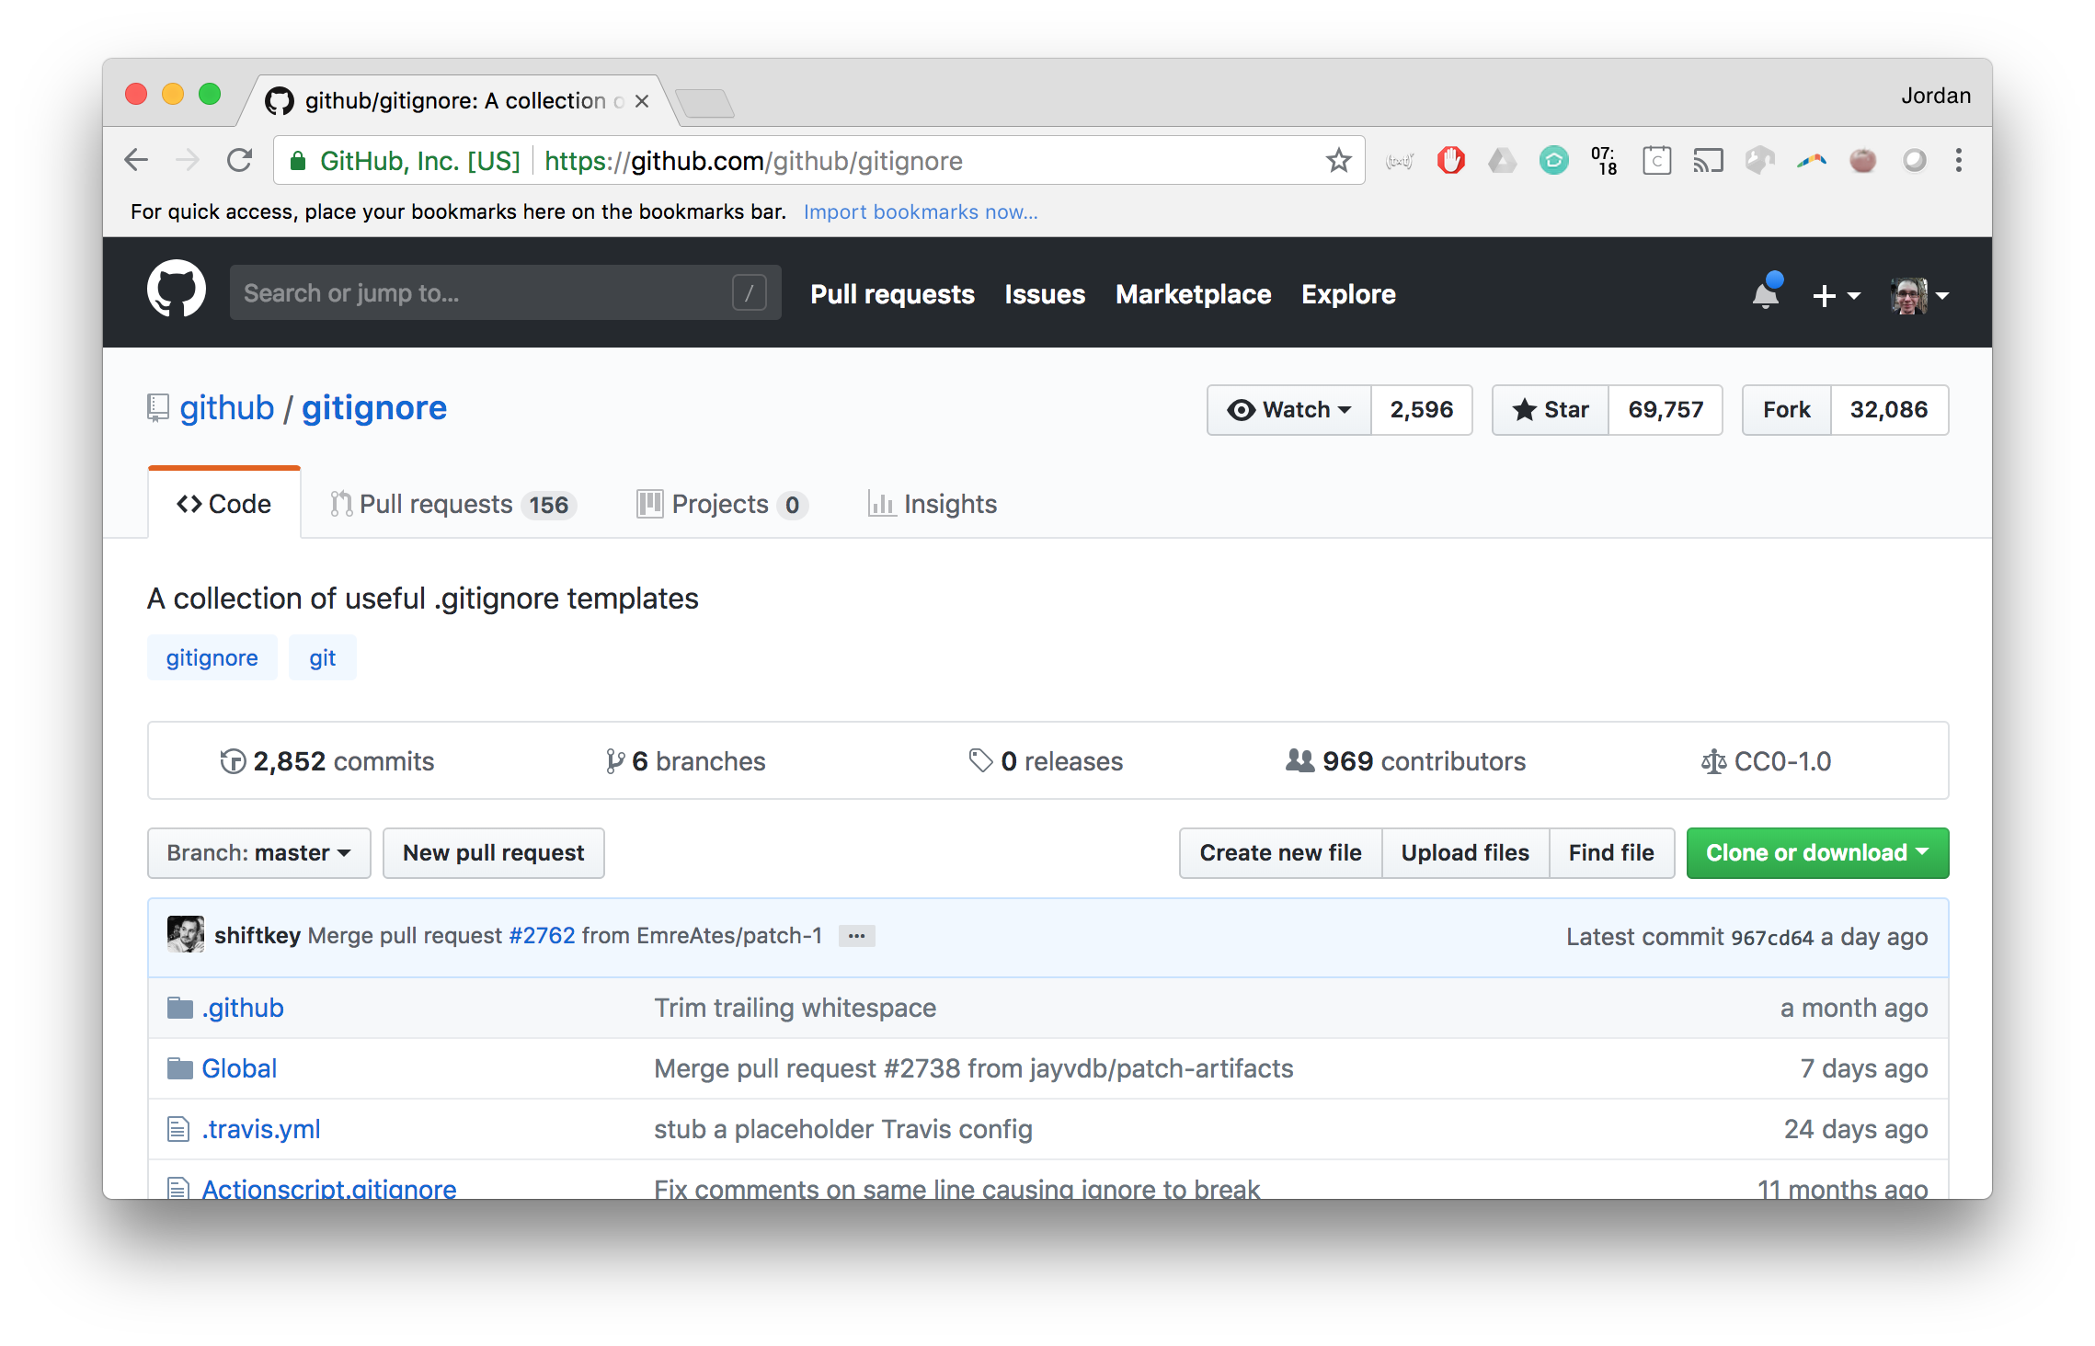
Eventually…

Slide 6
The point
Other people need to be able to understand your code
Future you needs to be able to understand your code

Slide 7
The point
Other people need to be able to understand your code
Future you needs to be able to understand your code
… but how?

Slide 8
The point
Other people need to be able to understand your code
Future you needs to be able to understand your code
Document it
… but how?

Slide 9
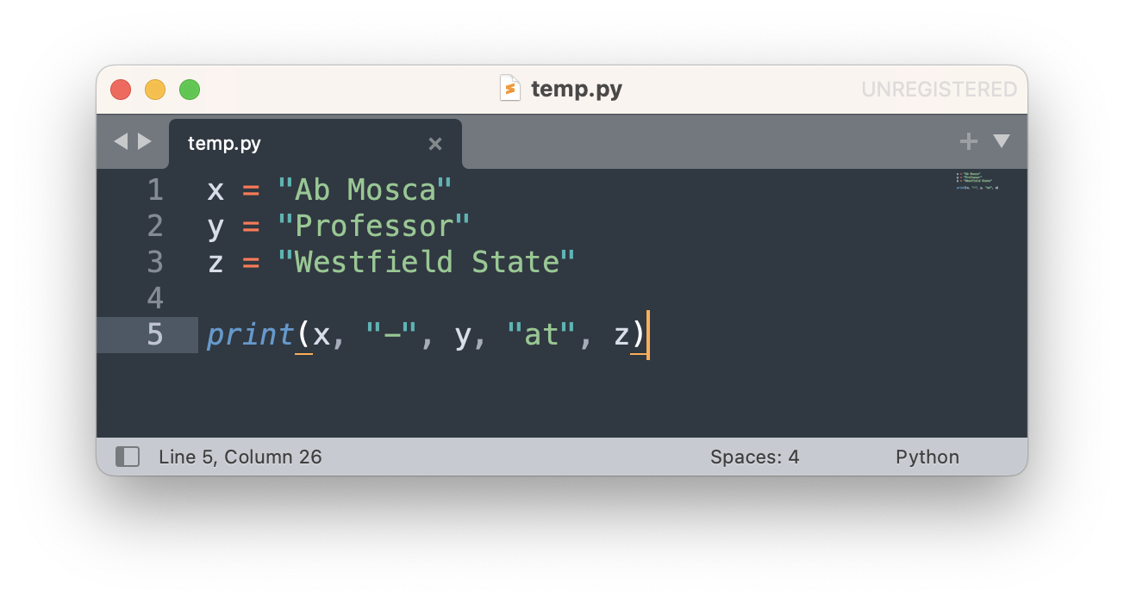
Step 1: meaningful nouns for variables

Slide 10
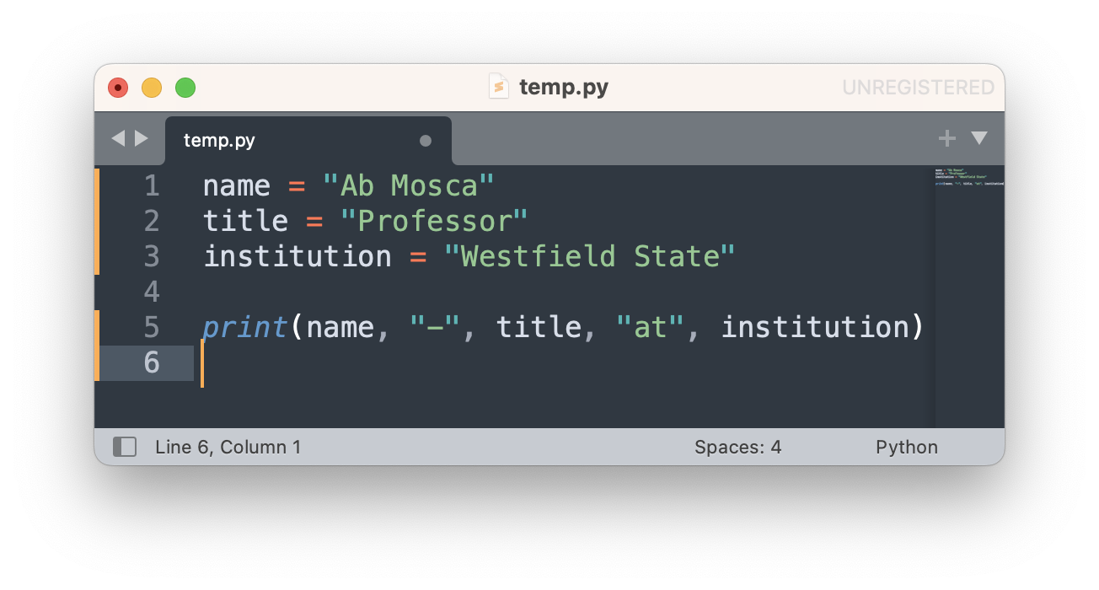
Step 1: meaningful nouns for variables

Slide 11
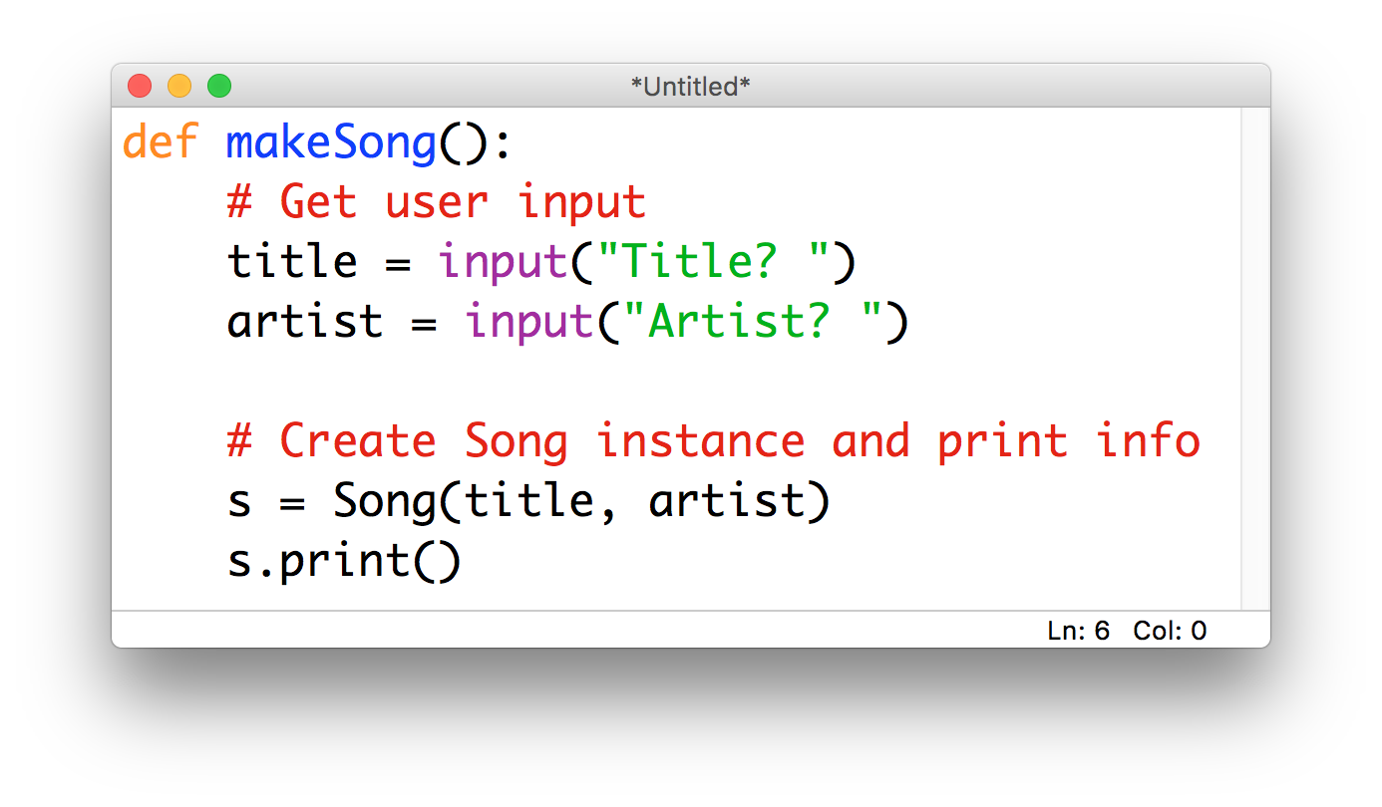
Step 2: lots of comments

Slide 12
A useful technique: code tracing
Given: a very short, poorly-documented program
Your goal: try to figure out what it’s doing
Recommendations:
walk through the program step-by-step (“trace its execution”) using the whiteboard or paper instead of running lines
once you understand what’s happening, then rewrite it using informative variable names and comments

Slide 13
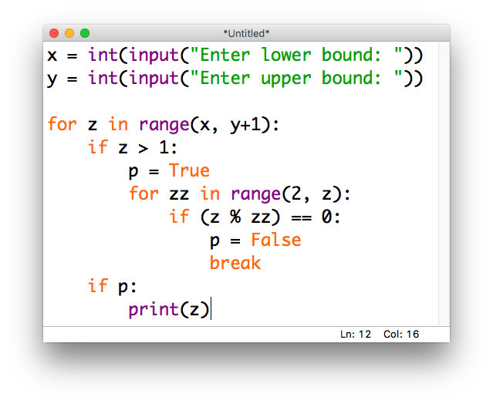
Example
Notes:
Pick nums for x and y and do out

Slide 14
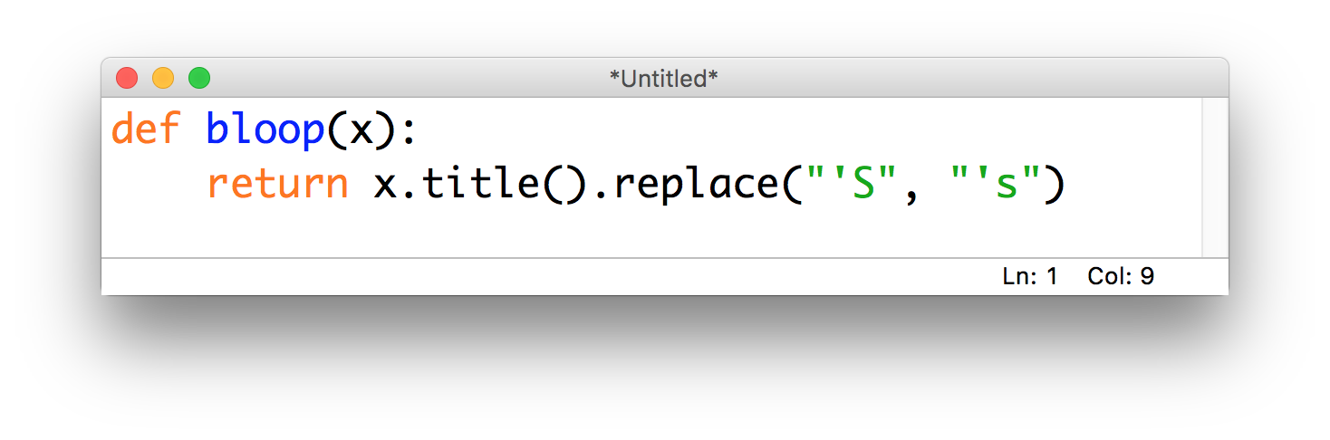
Step 3*: describe the action for functions

Slide 15
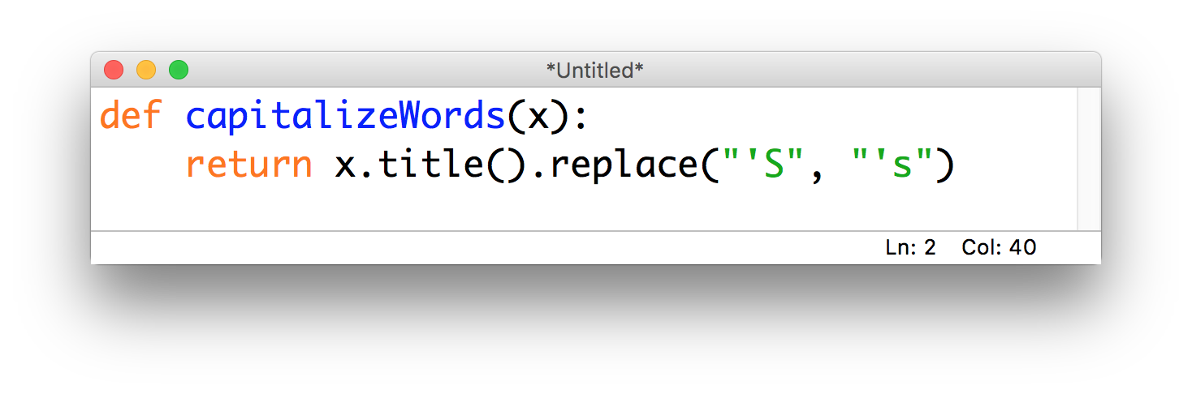
Step 3*: describe the action for functions

Slide 16
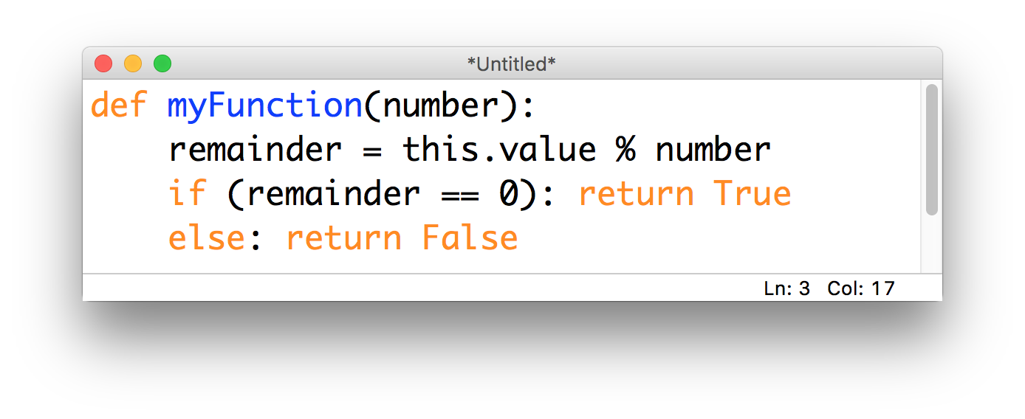
Step 3*: describe the action for functions

Slide 17
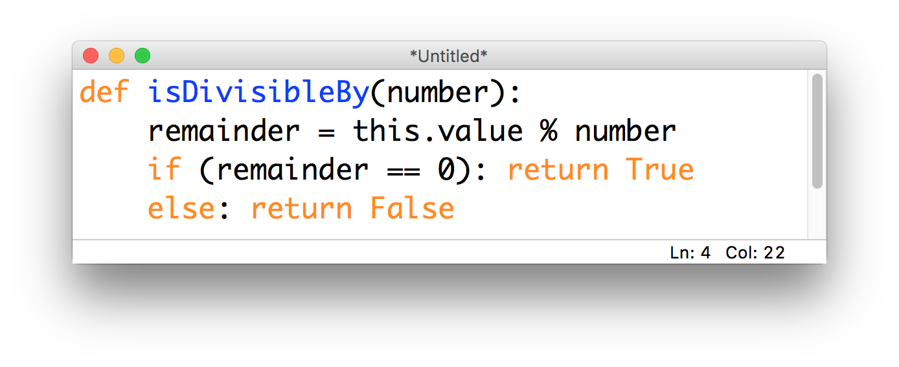
Step 3*: describe the action for functions

Slide 18
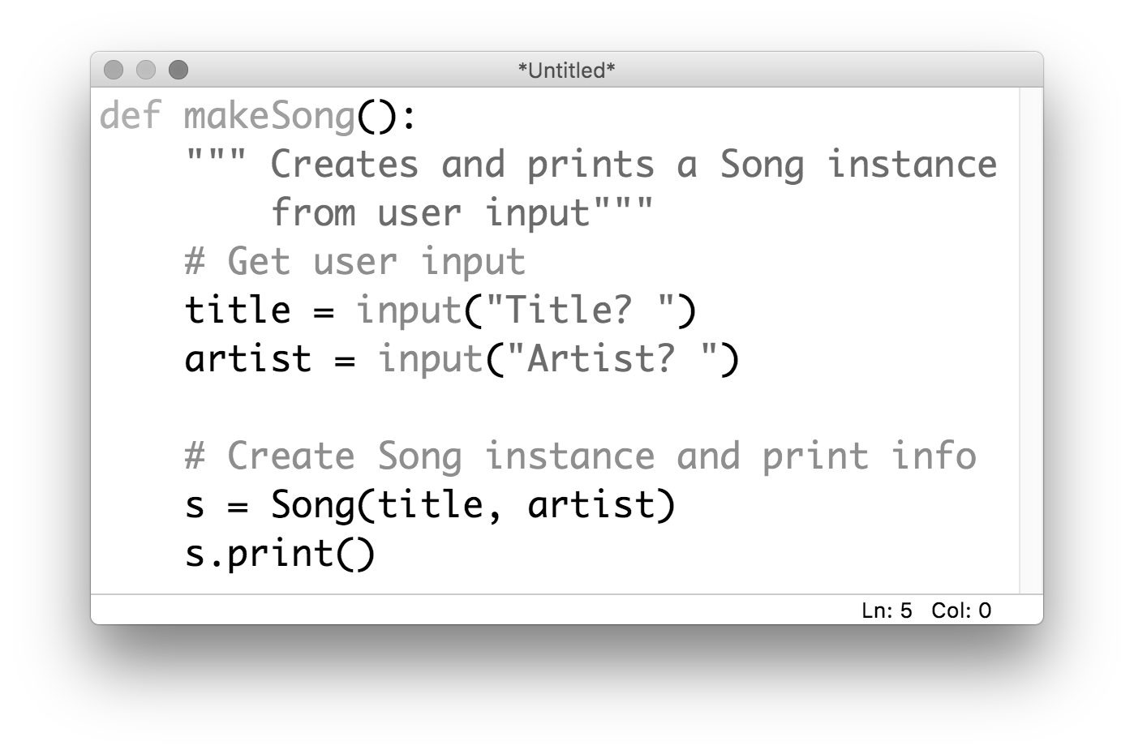
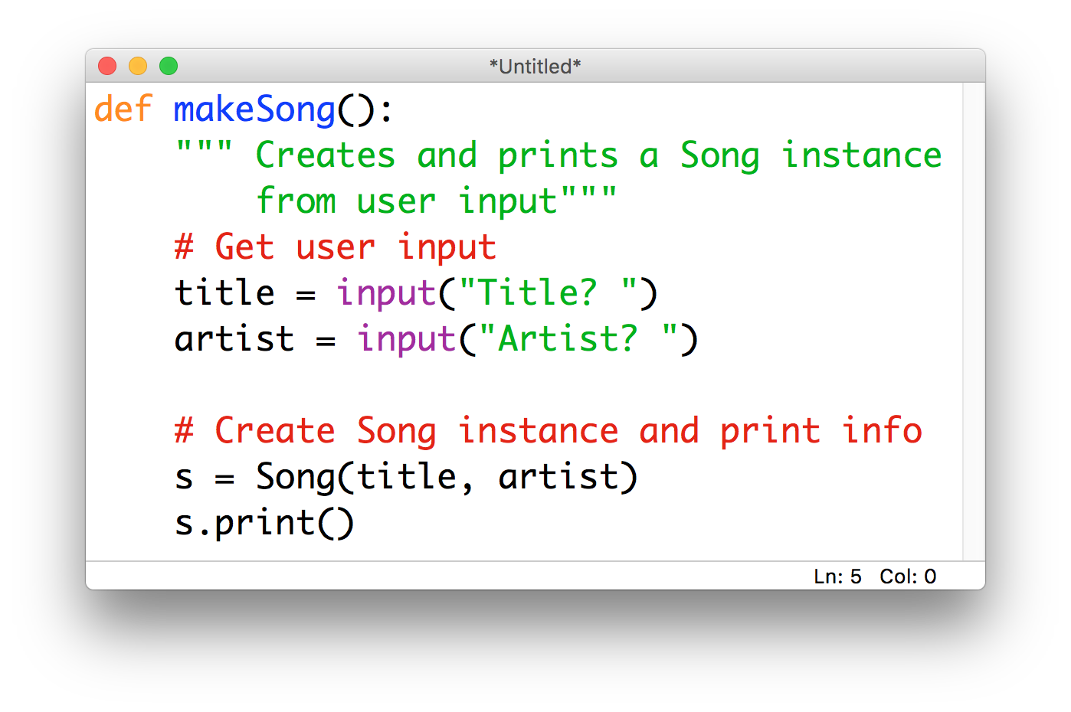
Step 4*: docstrings
Notes:
Python documentation strings (docstring) are a convenient way of associating documentation with modules, functions, classes, and methods.
An docstring is defined by including a multiline string as the first statement in the object‘s definition.
It's specified in source code and is used, like a comment, to document a specific segment of code.
The docstring should describe what the function does, not how. In big-kid programming, EVERY FUNCTION should have one.
It might look like just another comment, but it has some really cool functionality

Slide 20
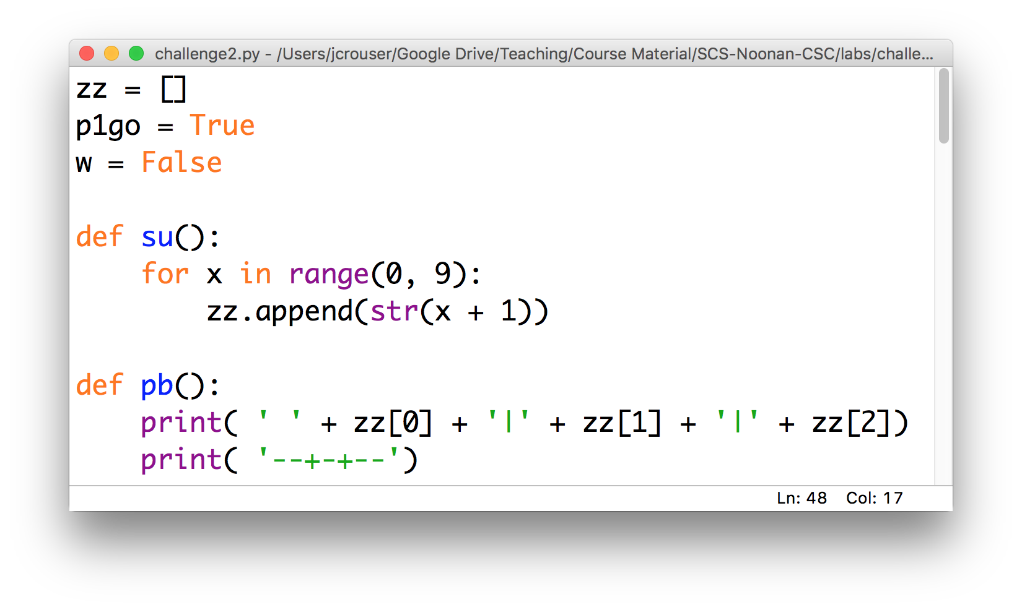
Activity: “code detective”
challenge2.py

